Slide 1


CMR TECHNICAL CAMPUS UGC(Autonomous) Kandlakoya, Medchal Road, Hyd-501401 Department of Computer Science and Engineering A Major Project Final Review USER BEHAVIOUR PREDICTION OF SOCIAL HOTSPOT BASED ON MULTI MESSAGE INTERACTION AND NEURAL NETWORK Batch No : 04
Group Members: Under the Guidance of :
Veldhandi Kavya(207R1A05P6) Dr. D.T.V. Dharmajee Rao
Dongari Abhilash Varma (207R1A05K8) Professor of CSE & Dean Academics
Dharavath Hanumu (207R1A05K7)

Slide 2
Contents :
Abstract
Existing System
Disadvantages of Existing System
Proposed System
Advantages of Proposed System
Hardware and Software Requirements
Novelty of the Project
Architecture
Modules
UML Diagrams
Sample Code
Result
Conclusion
Future Scope
Reference
Github Link

Slide 3
Abstract :
In today's online world, knowing how users behave in social hotspots is vital for things like targeted ads and content suggestions. This study introduces a smart way to predict user behavior in these hotspots.
We start by gathering lots of data on how users interact on social platforms - things like likes, comments, and shares. Then, we build a model that looks at all these interactions together, capturing the full picture of what's happening in the hotspot.
To make predictions, we use neural networks - fancy math tools that are great at finding hidden patterns. These networks, like recurrent and convolutional ones, help us see trends over time and understand how different interactions relate to each other.
Tests on real data show that our approach works really well, beating out other methods. This means we can better understand what drives user actions in social hotspots, which is super helpful for managing online communities and making smarter decisions.

Slide 4
Existing System :
The existing system for predicting user behavior in social hotspots through multi-message interaction and neural networks encompasses a comprehensive process.
It begins with the collection of diverse data from social media platforms, including likes, comments, shares, and other engagement metrics, followed by the extraction of meaningful features such as temporal patterns, textual content, and network structures.
These features are then fed into a multi-message interaction model, which effectively captures the intricate relationships between different types of messages within social hotspots. Neural network architectures, including recurrent and convolutional models, are employed to learn from this data, capturing both temporal dynamics and spatial dependencies in user behavior.
The models are trained and evaluated using standard metrics, and insights gleaned from their interpretation aid in understanding user engagement patterns and optimizing strategies for content promotion and community management within social hotspots.

Slide 5
Disadvantages of Existing System :
Neural networks are prone to overfitting, especially when trained on limited or biased data. This can lead to models that perform well on the training data but generalize poorly to new or unseen data, undermining the predictive accuracy of the system.
Training effective neural network models requires large amounts of data, which may not always be readily available, especially in niche or specialized domains. Acquiring and labeling sufficient data can be resource-intensive and time-consuming, posing challenges for practical implementation.
Neural network models, particularly deep architectures, are computationally intensive to train and require substantial computational resources, including high-performance GPUs or specialized hardware. This can present scalability challenges, particularly for real-time or large-scale applications.

Slide 6
Proposed System :
In this proposed system, Recurrent Neural Networks (RNNs) and Convolutional Neural Networks (CNNs) are integral components for effectively modeling and analyzing user behavior within social hotspots. RNNs are particularly useful for capturing temporal dynamics and sequential dependencies present in user interactions over time. They excel at learning patterns in the sequence of user actions, such as the order of engagement on a post or the progression of interactions across multiple messages within a hotspot.
CNNs are adept at extracting spatial features from structured data, making them valuable for processing textual content within social hotspots. By leveraging CNNs, the system can extract semantic features from posts, comments, and shares, capturing the underlying context and relationships between different user interactions.
By combining the strengths of both RNNs and CNNs, the proposed system can effectively model the complex dynamics and interactions present in social hotspots, leading to more accurate predictions of user behavior.

Slide 7
Advantages of proposed system :
By leveraging multi-message interaction data and neural network architectures, the system provides a comprehensive model for capturing the complex dynamics and relationships within social hotspots. It considers various types of user interactions, such as likes, comments, shares, and views, allowing for a holistic understanding of user behavior.
The implementation of real-time adaptation and feedback mechanisms, the system can continuously update and improve its predictive models based on incoming data.
The proposed system can be adapted to different social media platforms and domains, making it suitable for a wide range of applications. Its modular architecture allows for the incorporation of additional data sources, feature extraction techniques, and model improvements to enhance performance and adapt to evolving user behavior patterns.

Slide 8
Hardware and Software requirements :
Hardware requirements :
Processor :11th Gen Intel(R) Core(TM) i5-1135G7 @ 2.40GHz
RAM : 8.00 GB
Software requirements :
Coding Language : Python.
Front-End : Python.
Back-End : Django
Designing : Html, css, javascript.

Slide 9
Novelty of Project :
Integration of Multi-Message Interaction Data
Incorporation of Neural Network Architectures
Semantic Analysis of Textual Content
Real-Time Adaptation and Feedback
Interpretability and Explainability

Slide 10
Architecture:

Slide 11
User login
Upload details
Add tweet
Register and Login
Upload Dataset
Add Tweet
View All upload Tweets
User
Likes
Sends all details to service provider
Storing in a database
Rate
Dislike
Review
Extracting data
Capturing data
Admin can prepare data to analyse
Applying RNN
Applying CNN
Database
Capturing temporal dynamics and sequential dependencies in user interaction.
extracting spatial features from structured data.
Service Provider
Positive Analysis
Negative Analysis
Modified based on the changes done to graph data
Analysis section
Modified Graph Data
Analyzing tweets
Admin Login

Slide 12
Modules:
Data Preprocessing
Feature Engineering
Neural Network Architecture Design
Multi-Modal Fusion
Training Strategy
Model Evaluation
Interpretability and Insights
Deployment and Integration

Slide 13
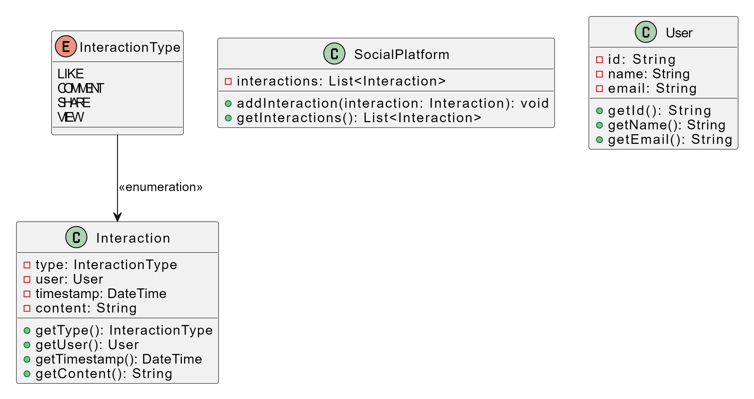
UML Diagrams:
Class Diagram:

Slide 14
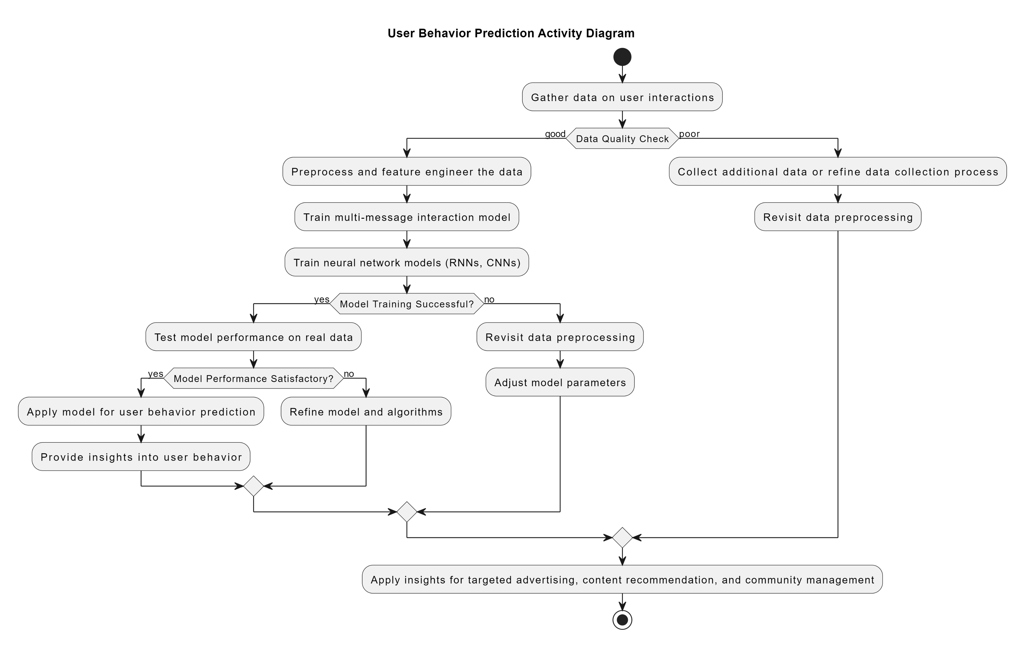
Activity Diagram:

Slide 15
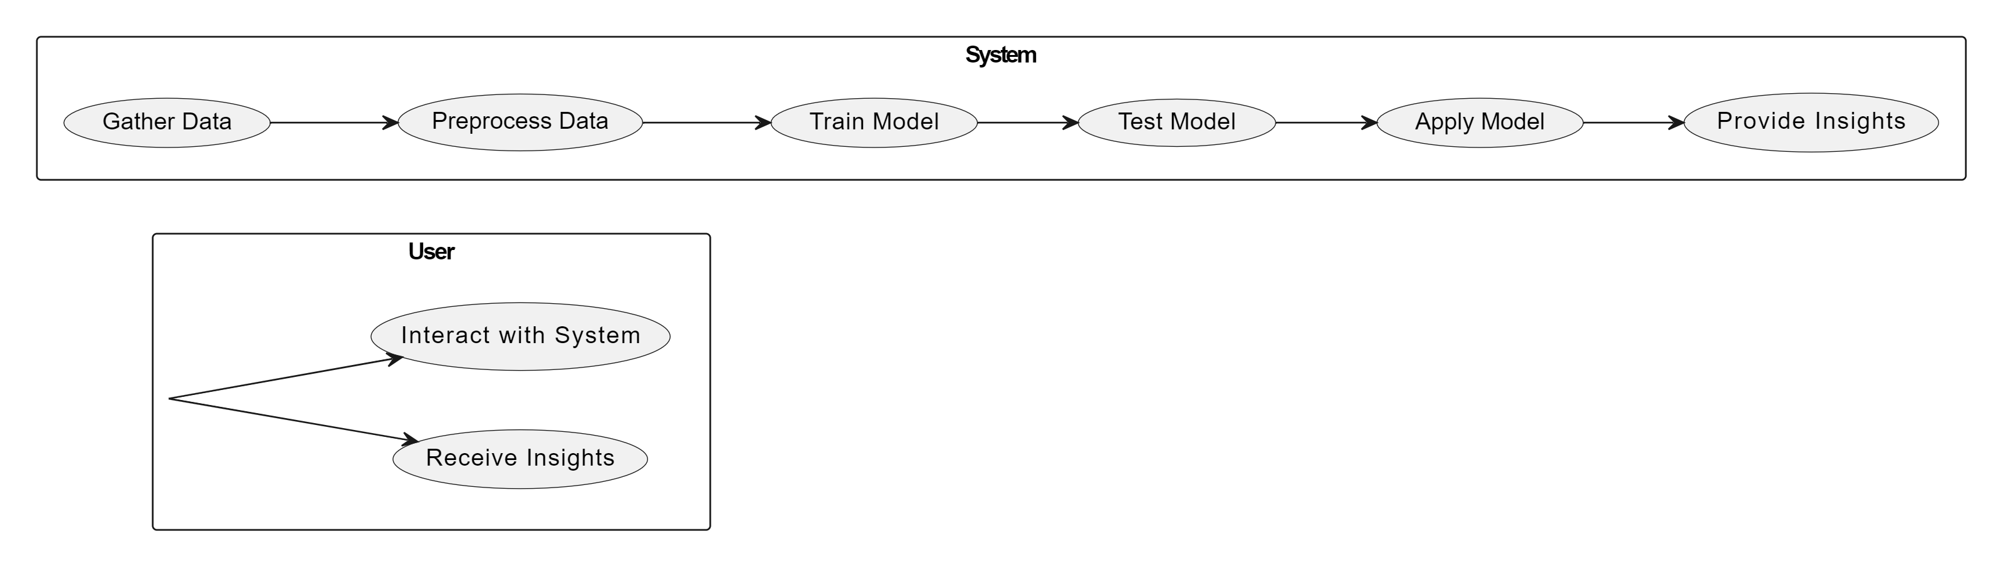
Usecase Diagram:

Slide 16
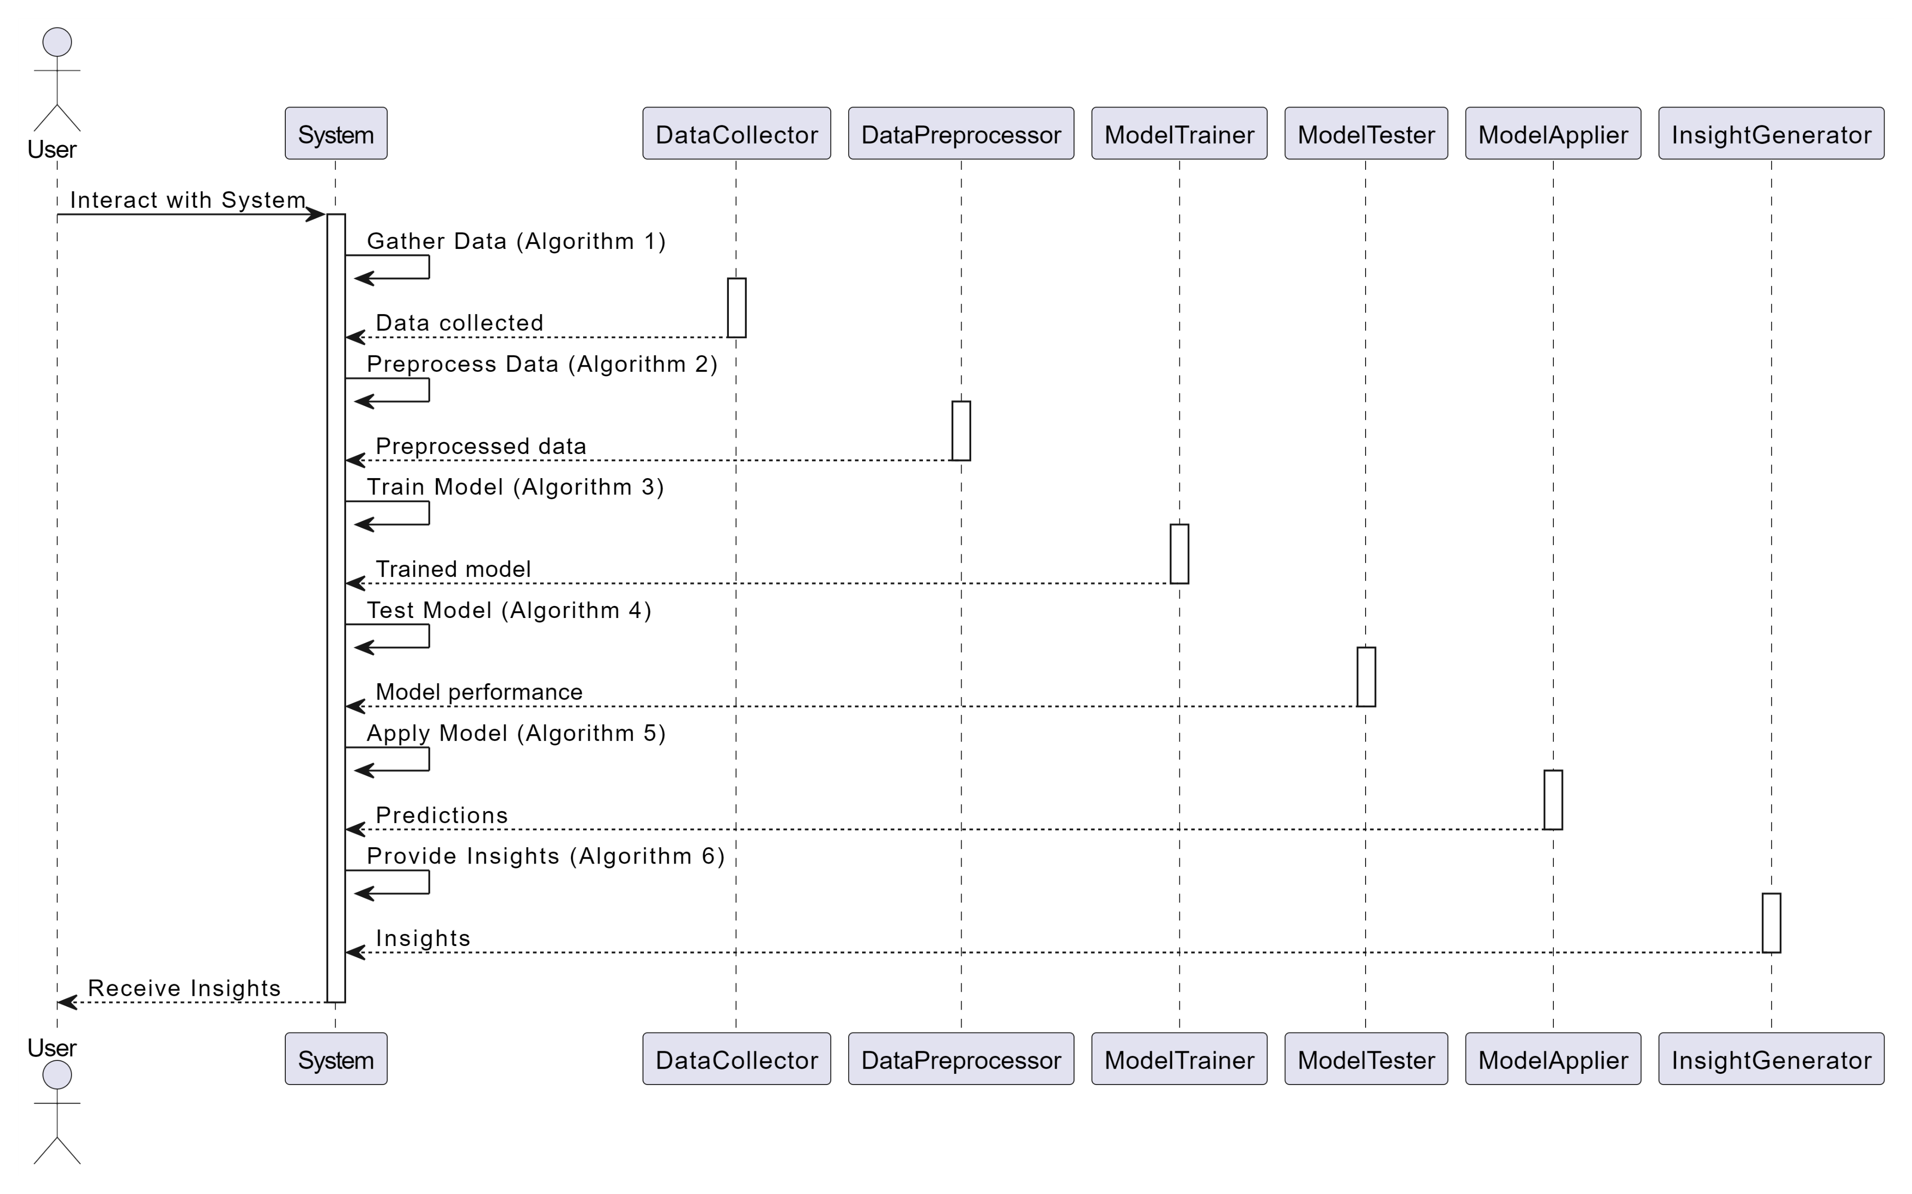
Sequence Diagram:

Slide 17
Sample Code:
<?xml version="1.0" encoding="UTF-8"?>
<project version="4">
<component name="ChangeListManager">
<list default="true" id="cf2f6933-f927-4da6-9ab9-39542e6f30c8" name="Default" comment="" />
<option name="EXCLUDED_CONVERTED_TO_IGNORED" value="true" />
<option name="TRACKING_ENABLED" value="true" />
<option name="SHOW_DIALOG" value="false" />
<option name="HIGHLIGHT_CONFLICTS" value="true" />
<option name="HIGHLIGHT_NON_ACTIVE_CHANGELIST" value="false" />
<option name="LAST_RESOLUTION" value="IGNORE" />
</component>
<component name="FileEditorManager">
<leaf SIDE_TABS_SIZE_LIMIT_KEY="300">

Slide 18
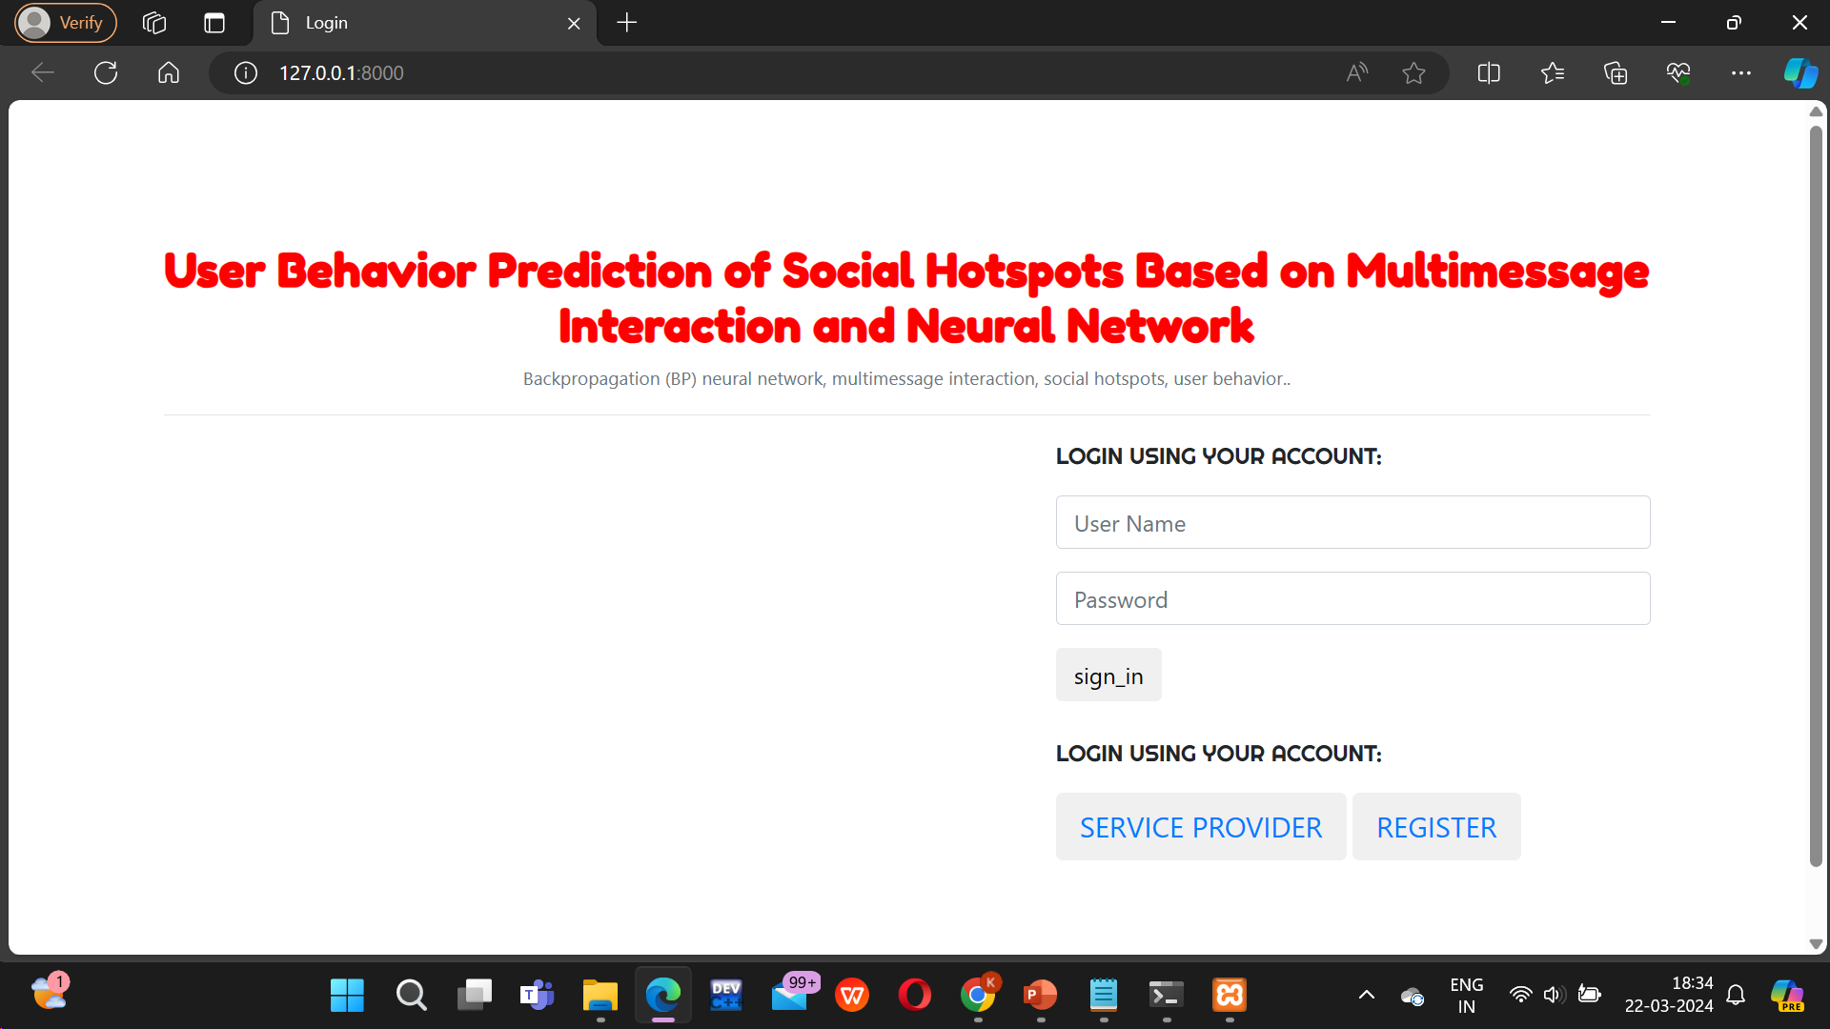
Results:

Slide 19
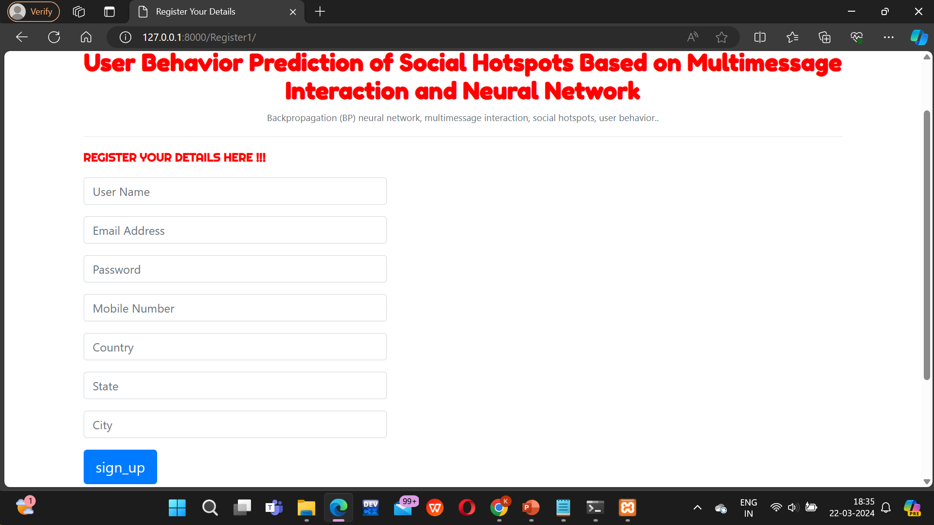

Slide 20
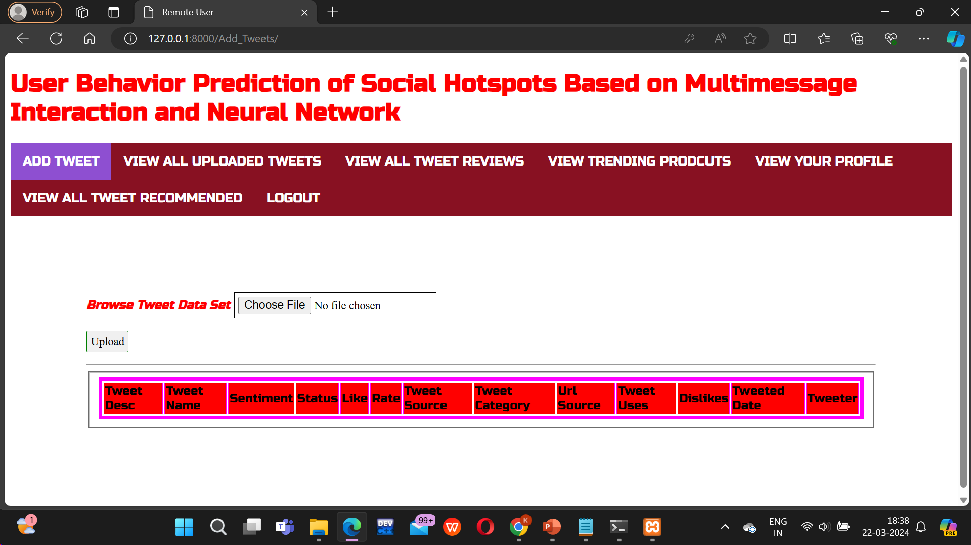
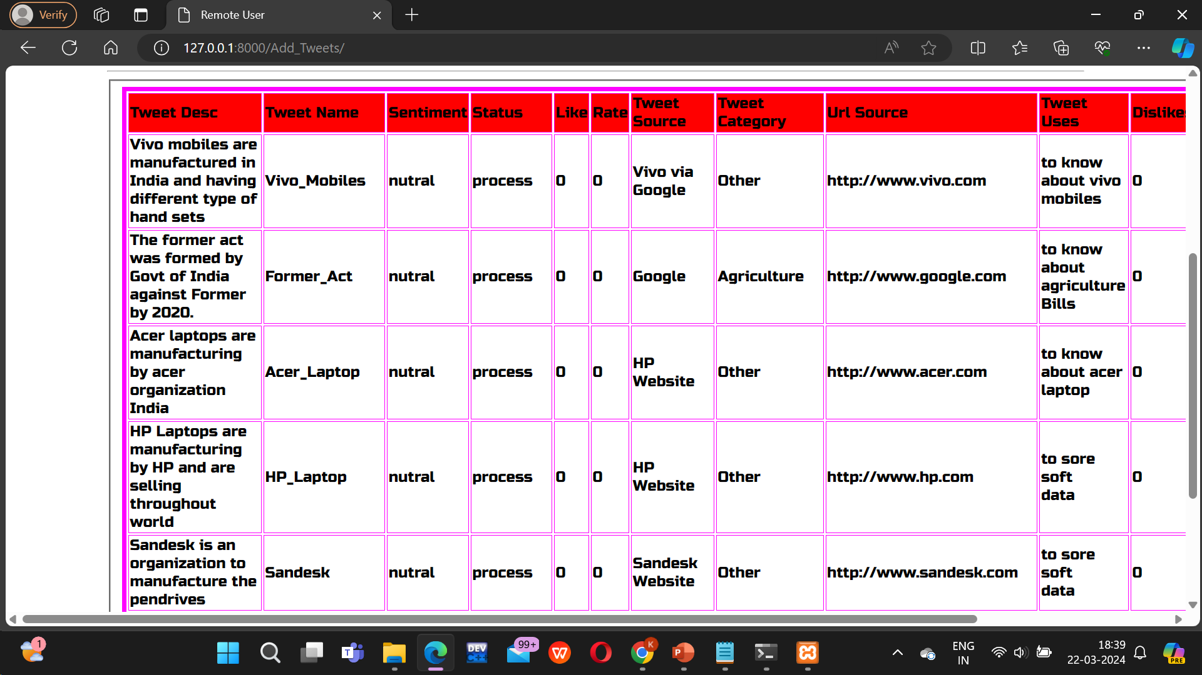

Slide 21
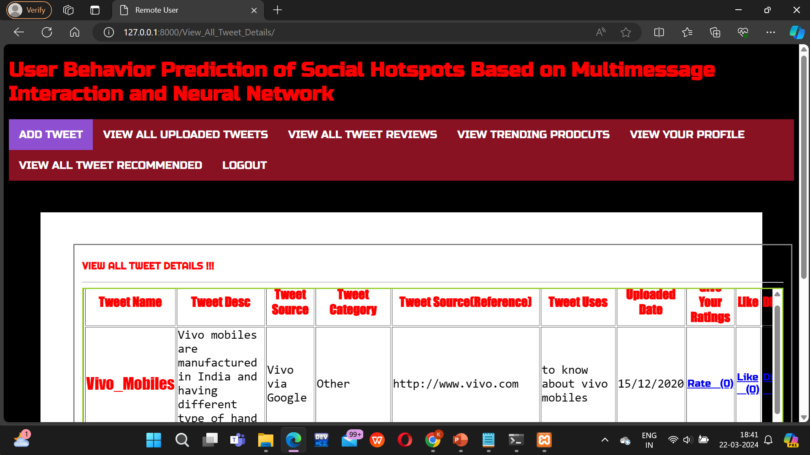
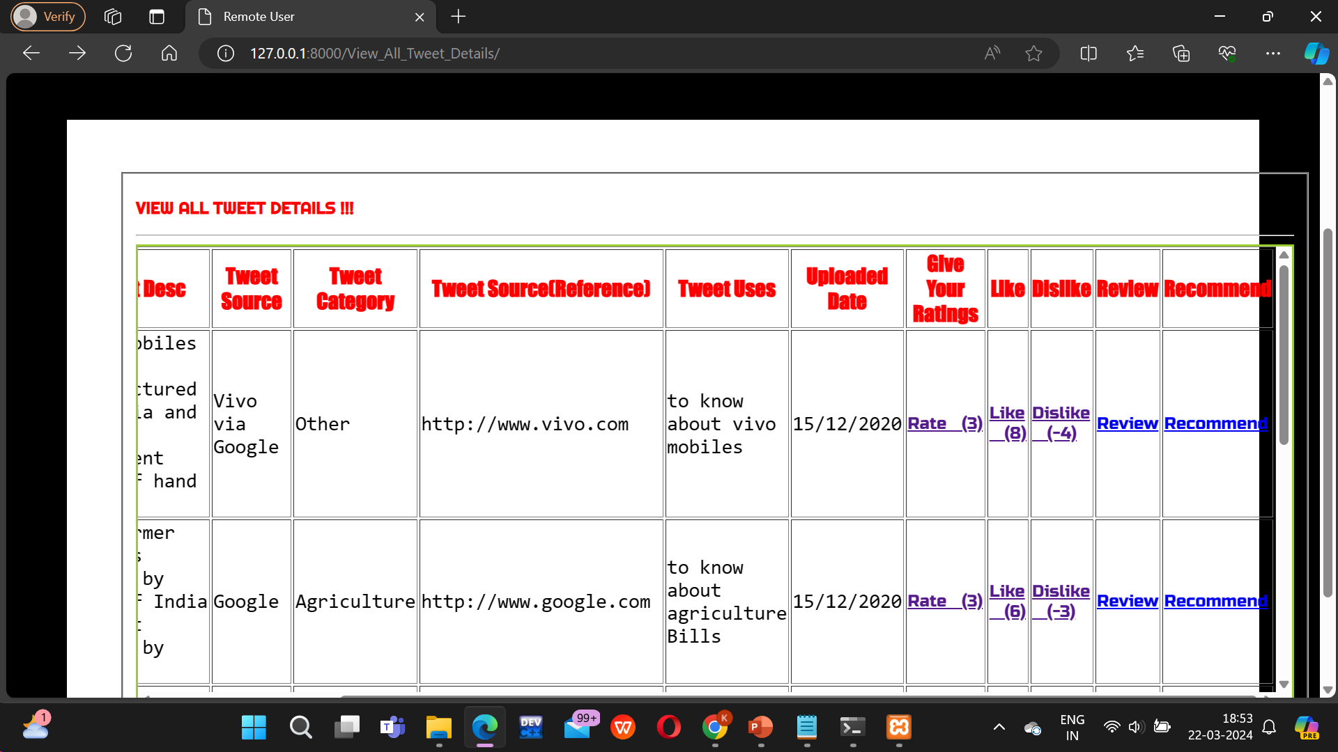

Slide 22
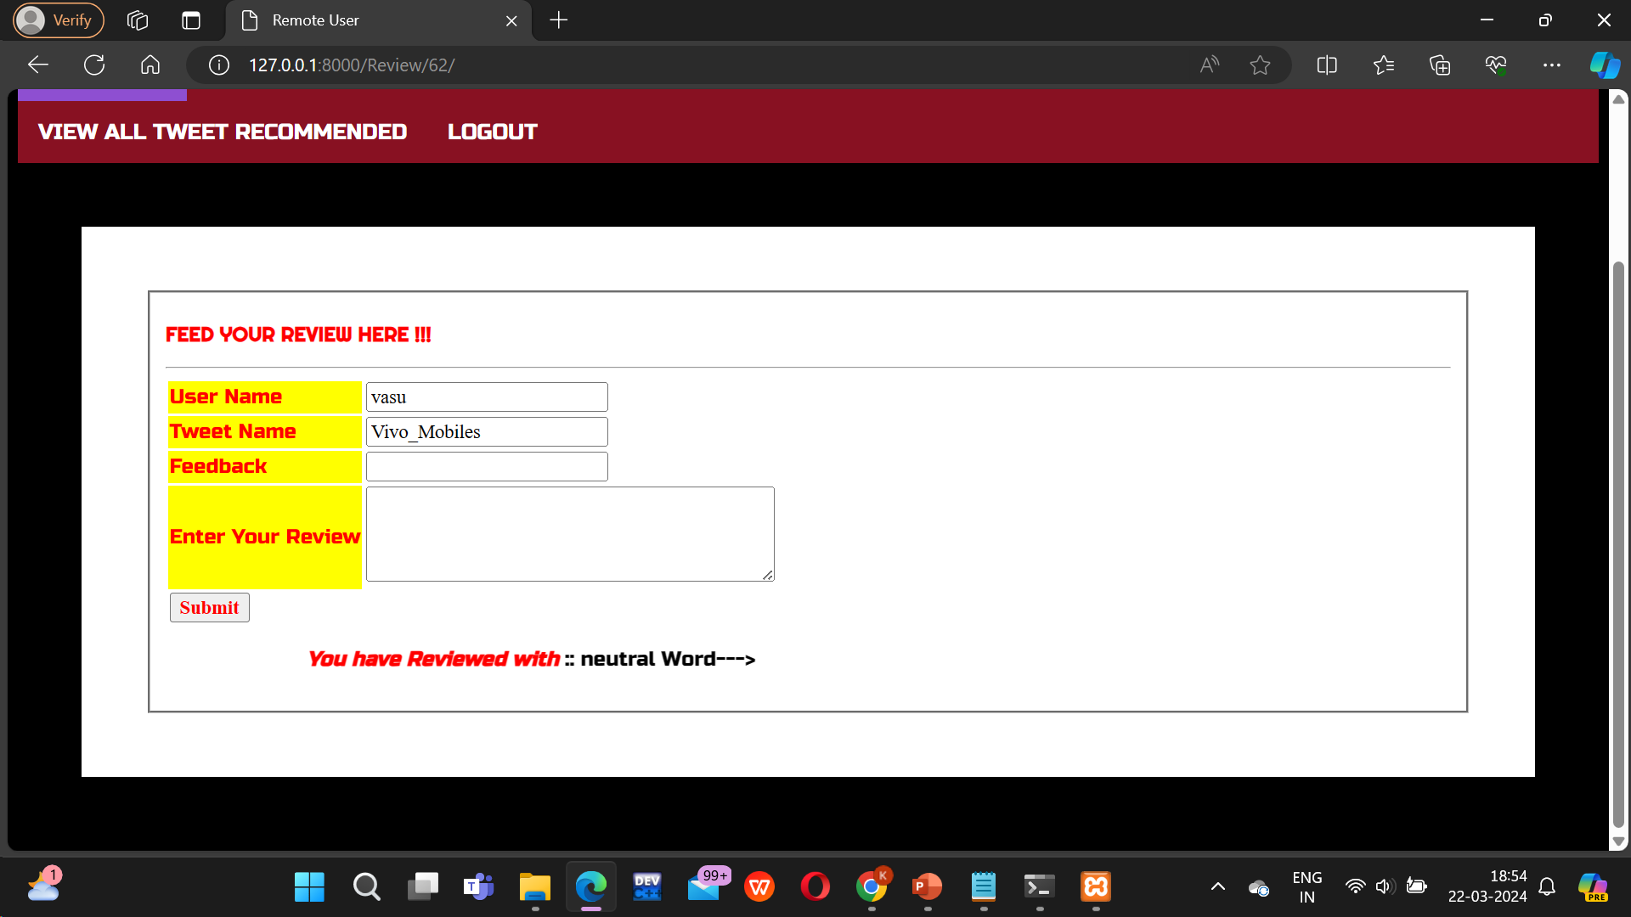
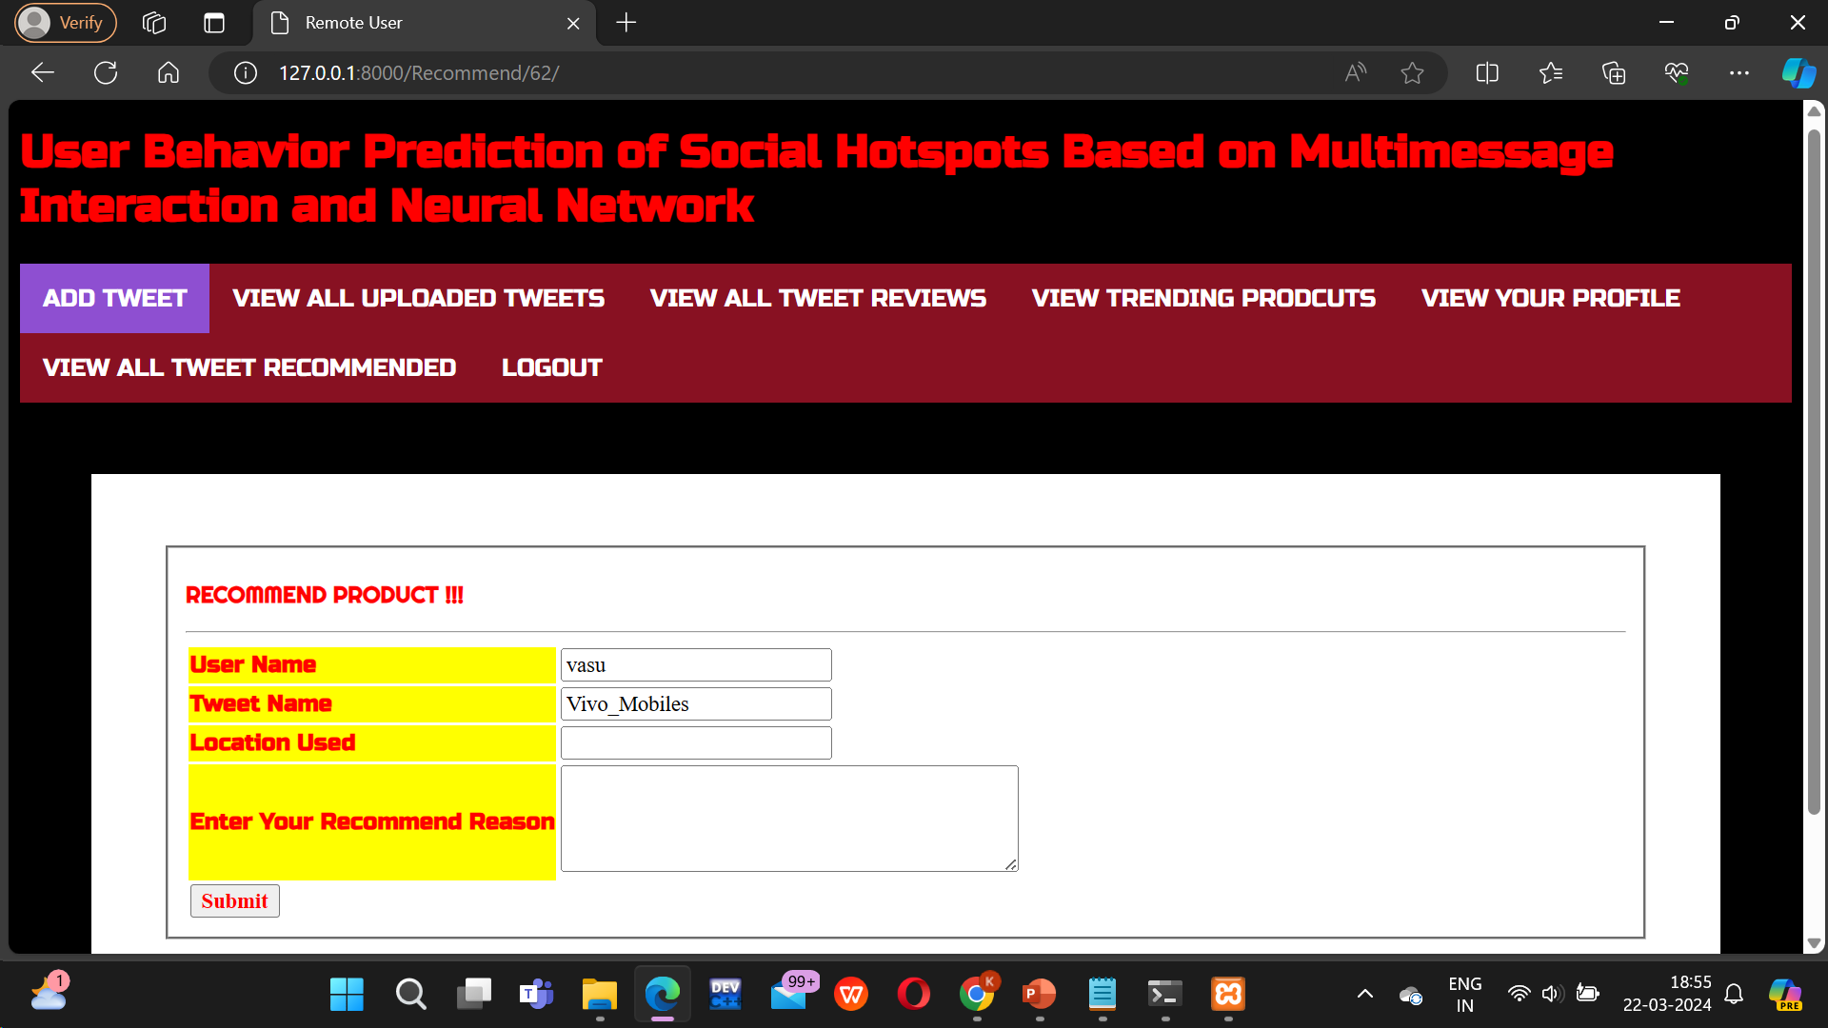

Slide 23
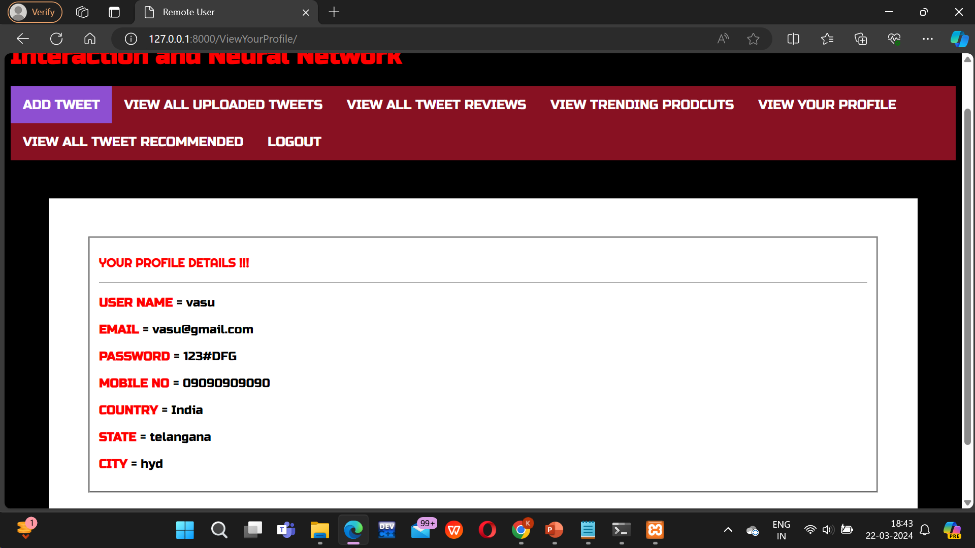

Slide 24
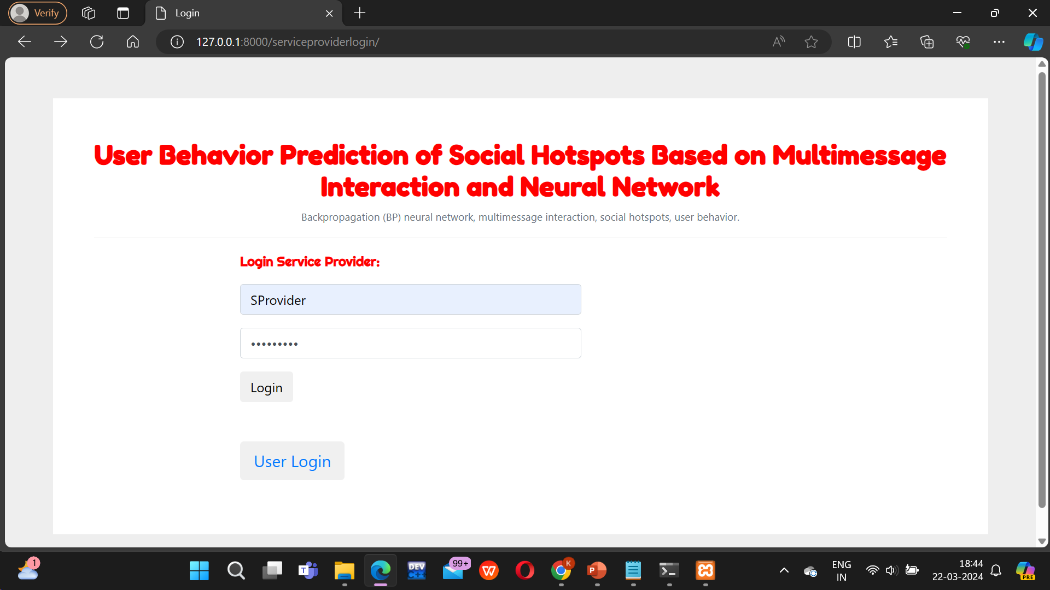

Slide 25
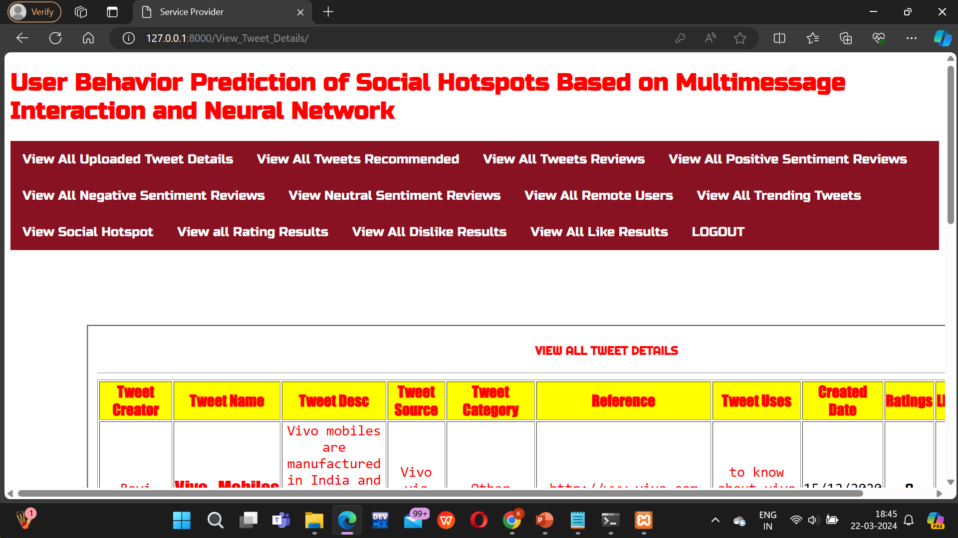

Slide 26
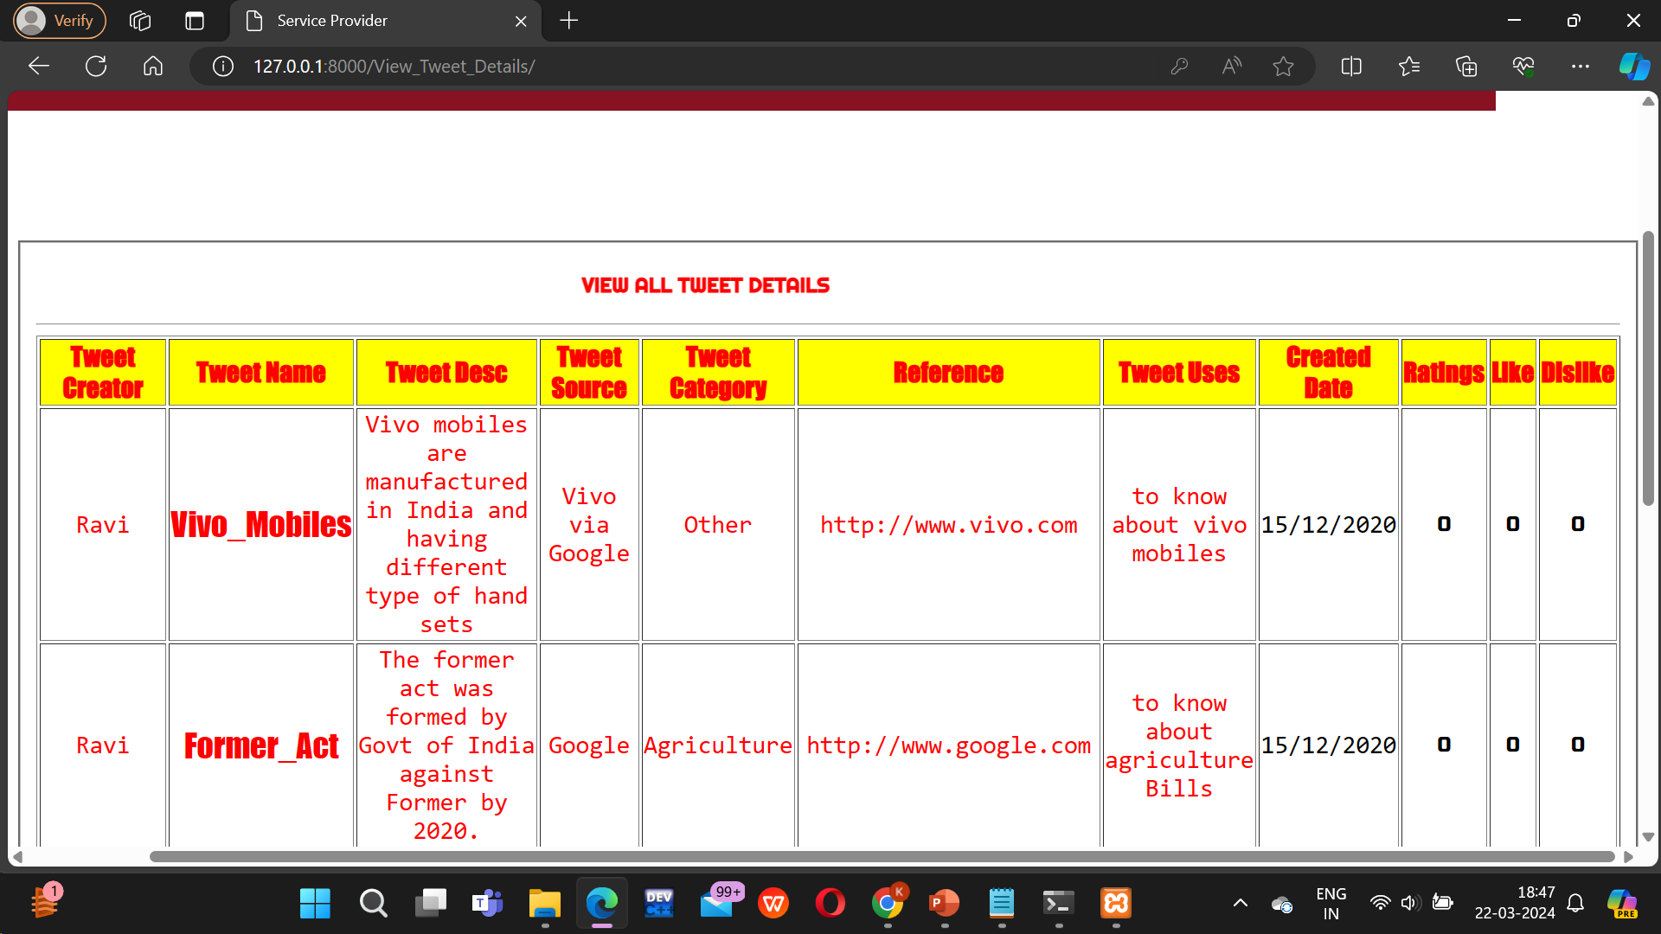

Slide 27
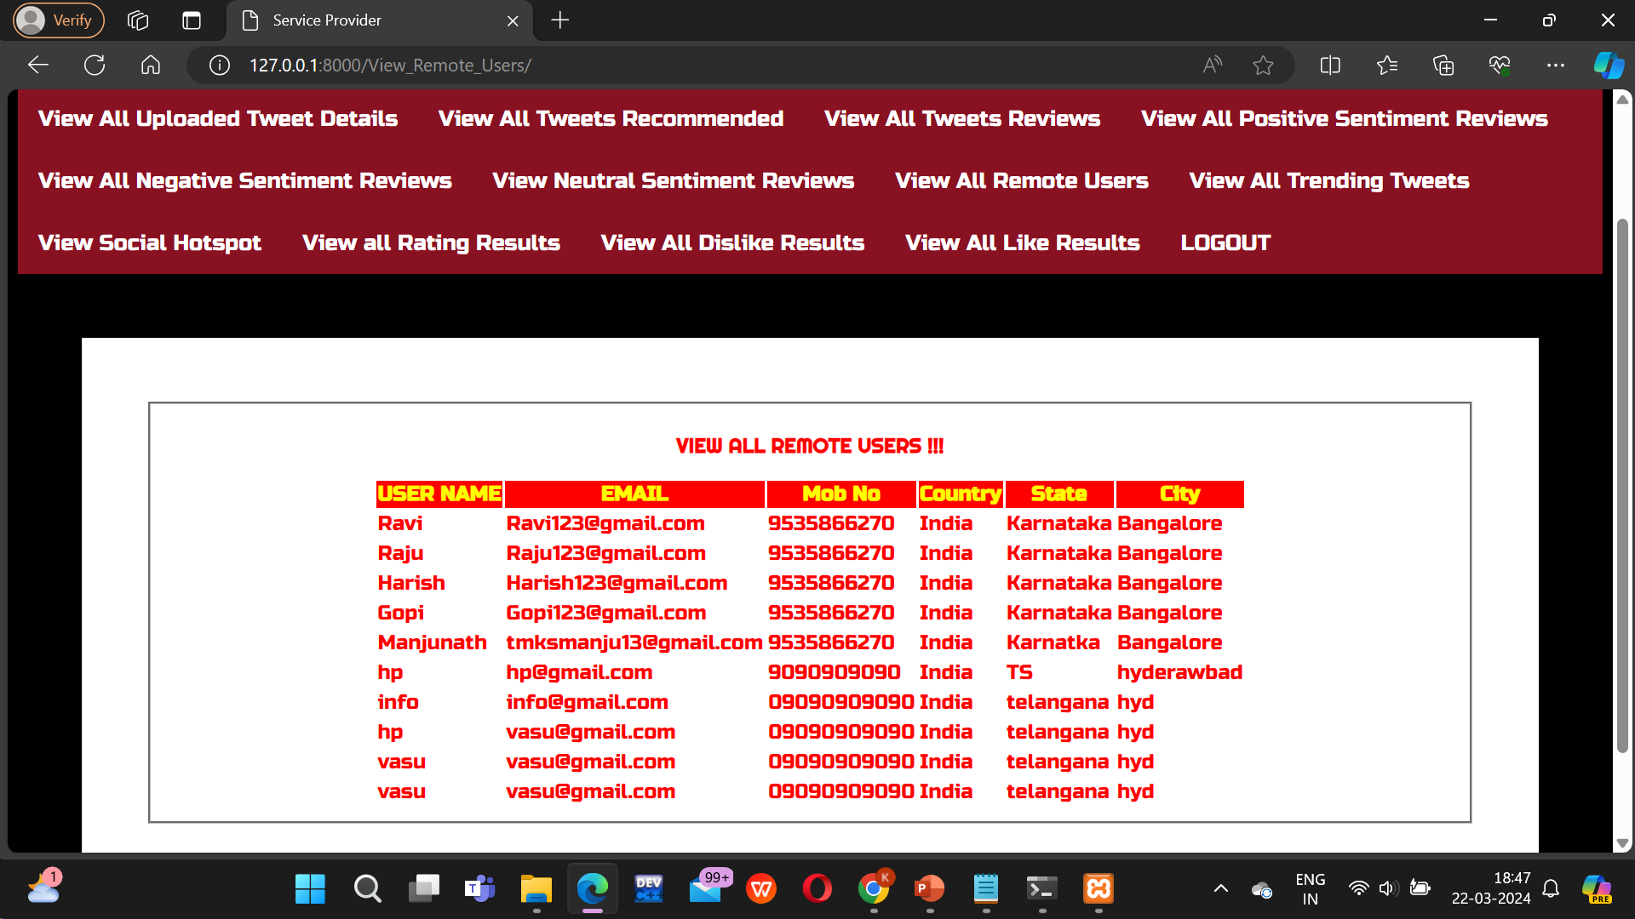

Slide 28
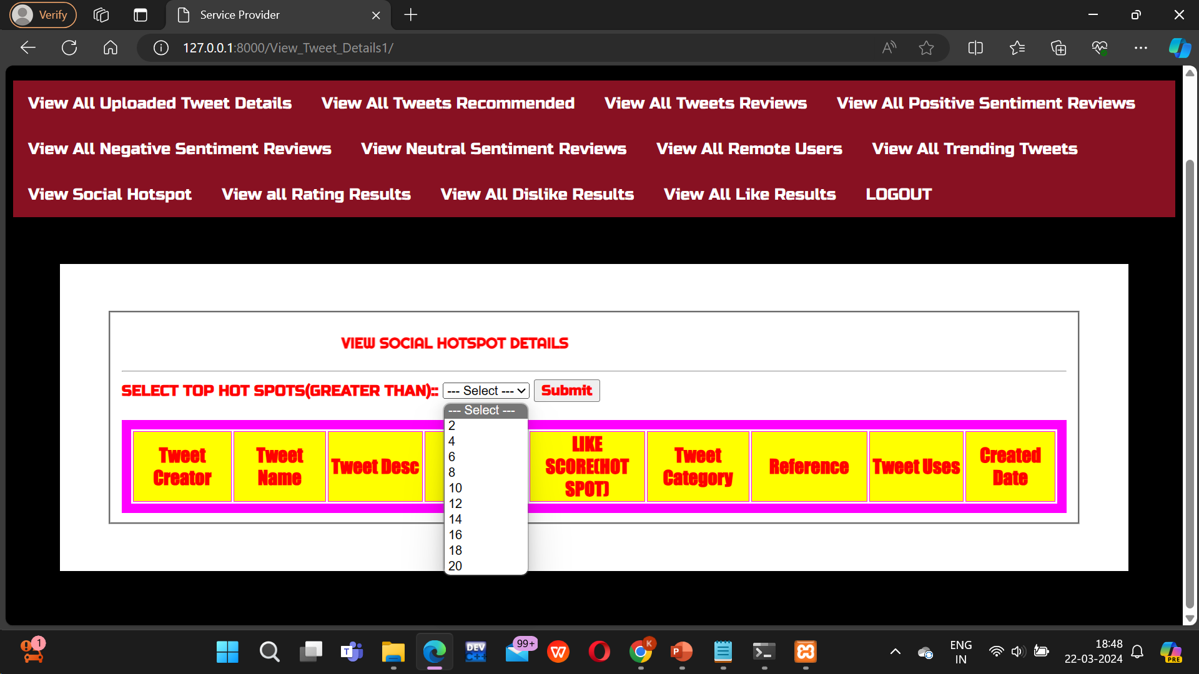

Slide 29
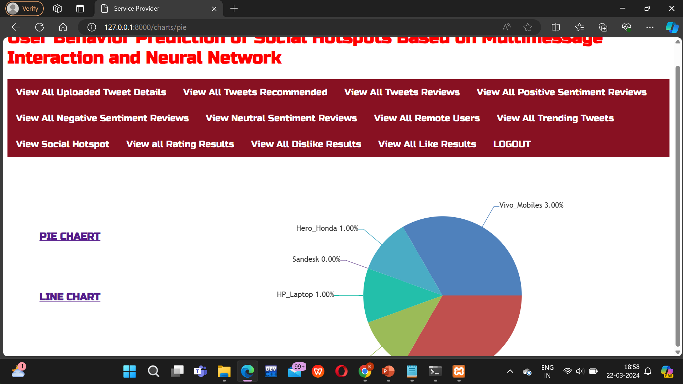

Slide 30
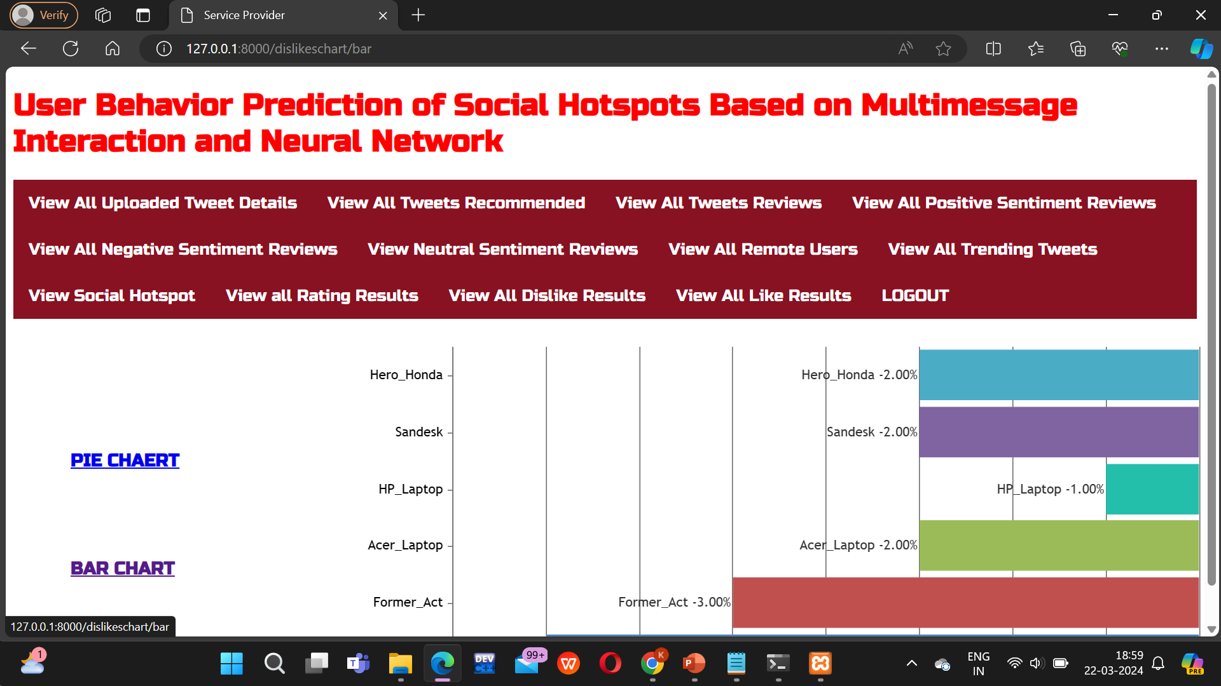

Slide 31
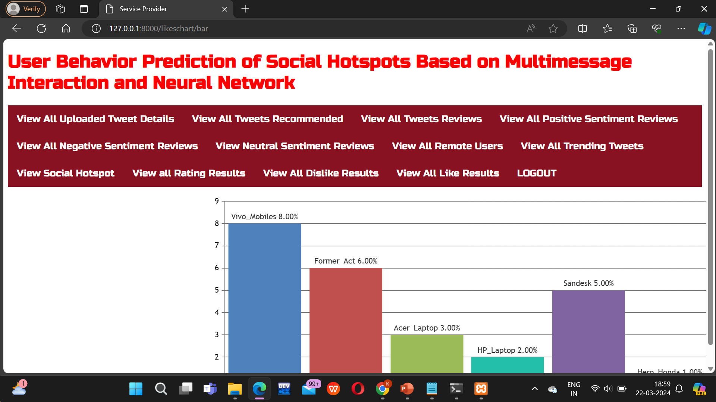

Slide 32
Conclusion :
In user behavior prediction of social hotspots based on multi-message interaction and neural networks offers a comprehensive and innovative approach to understanding and predicting user behavior within online communities. By integrating data from various types of user interactions and leveraging advanced neural network architectures, including Recurrent Neural Networks (RNNs) and Convolutional Neural Networks (CNNs), the system can capture the complex dynamics and relationships present in social hotspots.
The system's ability to model temporal dynamics, extract semantic features from textual content, and provide real-time adaptation and feedback further enhances its effectiveness and usability. Overall, this system represents a significant advancement in the field of social media analytics, offering valuable insights and practical solutions for enhancing user engagement and community dynamics within online platforms.

Slide 33
Future Scope :
Hybrid Models Integration
Real-time Prediction
Robustness to Adversarial Attacks
Multi-domain Adaptation
Long-tail Behaviour Prediction
Dynamic Community Detection
Multi-task Learning

Slide 34
Reference:
M. Takayasu, K. Sato, Y. Sano, K. Yamada, W. Miura and H. Takayasu, "Rumor diffusion and convergence during the 3.11 earthquake: A Twitter case study", PLoS ONE, vol. 10, no. 4, Apr. 2015
S. Gaglio, G. Lo Re and M. Morana, "A framework for real-time Twitter data analysis", Comput. Commun., vol. 73, pp. 236-242, Jan. 2016.
A. Mislove, M. Marcon, K. P. Gummadi, P. Druschel and B. Bhattacharjee, "Measurement and analysis of online social networks", Proc. 7th ACM SIGCOMM Conf. Internet Meas., pp. 29-42, 2007.
J. Golbeck, C. Robles, M. Edmondson and K. Turner, "Predicting personality from twitter", Proc. IEEE 3rd Int. Conf. Privacy Secur. Risk Trust IEEE 3rd Int. Conf. Social Comput., pp. 149-156, Oct. 2011.

Slide 35
Github Link :
https://github.com/207r1a05p6/major-project

